Slide 1
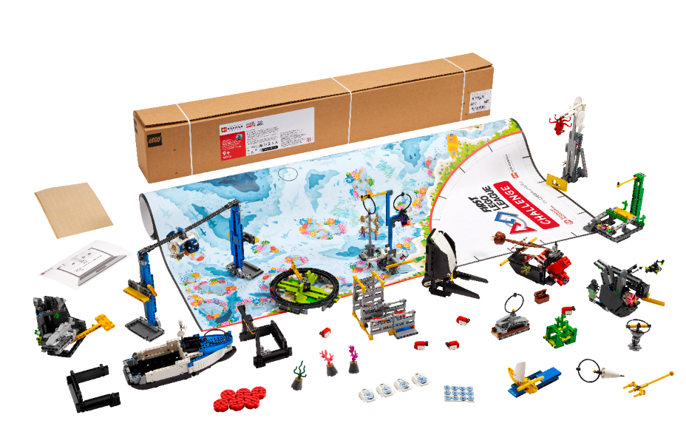


Session 8
Continue Creating
Notes:
Session 8 Tips =
Have the team discuss how the guided mission is an example of Coopertition®.
The team should think about strategy when choosing missions to solve. Multiple missions can be completed on the same run to save time.
Encourage the team to discuss how their program works. Break the program into blocks that control one movement.
Treat the robot game like a sport. The team needs to practice, practice, practice to perform well in the robot game.
Where the robot starts in a launch area strongly influences where it ends. Have the team keep good notes about where the robot is placed.

Slide 2
Session Overview
Outcomes
Evaluate and improve on their innovation project solution.
Design robot attachments and create programs to solve missions.
Notes:
Outcomes
Evaluate and improve on their innovation project solution.
Design robot attachments and create programs to solve missions.
Facilitator Tips - Use the Core Values where appropriate to encourage the team. To celebrate the team learning these important values, highlight examples of when the team demonstrates these principles.
Session 8 Tips =
Have the team discuss how the guided mission is an example of Coopertition®.
The team should think about strategy when choosing missions to solve. Multiple missions can be completed on the same run to save time.
Encourage the team to discuss how their program works. Break the program into blocks that control one movement.
Treat the robot game like a sport. The team needs to practice, practice, practice to perform consistently in the robot game.
Where the robot starts in a launch area strongly influences where it ends. Have the team keep good notes about where to place the robot.
The team can create a survey to evaluate their solution or ask for feedback from an expert or user of their chosen problem.
The team should iterate and improve their innovation project solution following feedback from others.
Consider inviting an expert or user to this session to share content about their identified problem.
The team should reference the rubrics so they can be prepared for judging at the event.
The team should think about who their innovative project solution is for.

Slide 3
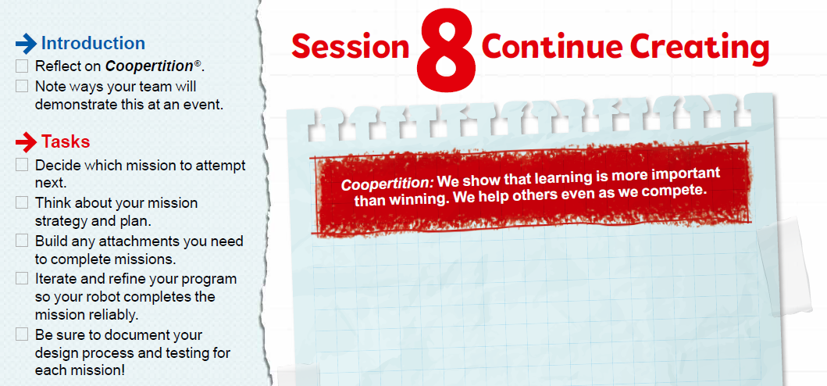

Introduction
Reflect on Coopertition®.
Note ways your team will demonstrate this at an event.
Notes:
Introduction (10-15 minutes)
Outcomes
Evaluate and improve on their innovation project solution.
Design robot attachments and create programs to solve missions.
Facilitator Tips - Use the Core Values where appropriate to encourage the team. To celebrate the team learning these important values, highlight examples of when the team demonstrates these principles.
Session 8 Tips =
Have the team discuss how the guided mission is an example of Coopertition®.
The team should think about strategy when choosing missions to solve. Multiple missions can be completed on the same run to save time.
Encourage the team to discuss how their program works. Break the program into blocks that control one movement.
Treat the robot game like a sport. The team needs to practice, practice, practice to perform consistently in the robot game.
Where the robot starts in a launch area strongly influences where it ends. Have the team keep good notes about where to place the robot.
The team can create a survey to evaluate their solution or ask for feedback from an expert or user of their chosen problem.
The team should iterate and improve their innovation project solution following feedback from others.
Consider inviting an expert or user to this session to share content about their identified problem.
The team should reference the rubrics so they can be prepared for judging at the event.
The team should think about who their innovative project solution is for.

Slide 4
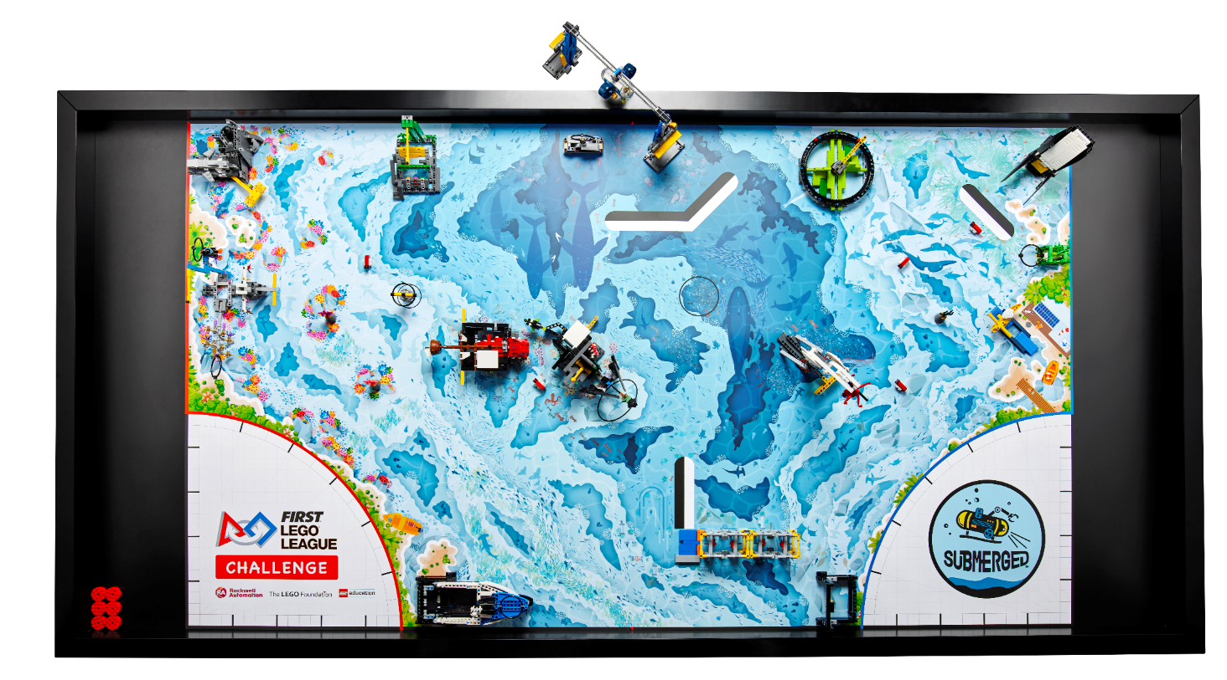
Solve Missions
Decide which mission to attempt next.
Think about your mission strategy and plan.
Build any attachments you need to complete missions.
Notes:
Team Tasks (100-120 minutes)
Outcomes
Evaluate and improve on their innovation project solution.
Design robot attachments and create programs to solve missions.
Facilitator Tips - Use the Core Values where appropriate to encourage the team. To celebrate the team learning these important values, highlight examples of when the team demonstrates these principles.
Session 8 Tips =
Have the team discuss how the guided mission is an example of Coopertition®.
The team should think about strategy when choosing missions to solve. Multiple missions can be completed on the same run to save time.
Encourage the team to discuss how their program works. Break the program into blocks that control one movement.
Treat the robot game like a sport. The team needs to practice, practice, practice to perform consistently in the robot game.
Where the robot starts in a launch area strongly influences where it ends. Have the team keep good notes about where to place the robot.
The team can create a survey to evaluate their solution or ask for feedback from an expert or user of their chosen problem.
The team should iterate and improve their innovation project solution following feedback from others.
Consider inviting an expert or user to this session to share content about their identified problem.
The team should reference the rubrics so they can be prepared for judging at the event.
The team should think about who their innovative project solution is for.

Slide 5
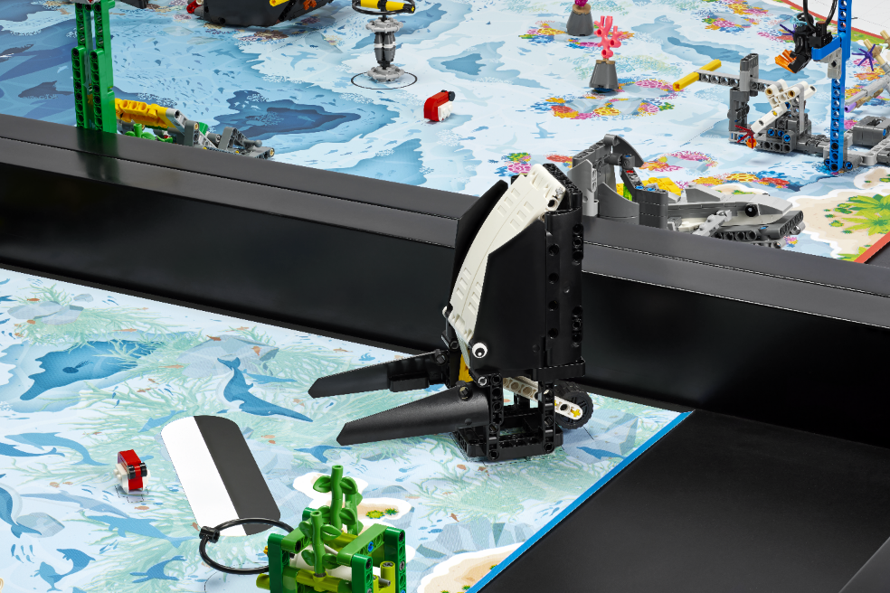
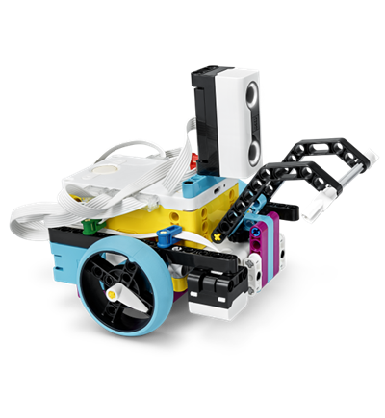
Solve Missions
Iterate and refine your program so your robot completes the mission reliably.
Be sure to document your design process and testing for each mission!
Notes:
Team Tasks (100-120 minutes)
Outcomes
Evaluate and improve on their innovation project solution.
Design robot attachments and create programs to solve missions.
Facilitator Tips - Use the Core Values where appropriate to encourage the team. To celebrate the team learning these important values, highlight examples of when the team demonstrates these principles.
Session 8 Tips =
Have the team discuss how the guided mission is an example of Coopertition®.
The team should think about strategy when choosing missions to solve. Multiple missions can be completed on the same run to save time.
Encourage the team to discuss how their program works. Break the program into blocks that control one movement.
Treat the robot game like a sport. The team needs to practice, practice, practice to perform consistently in the robot game.
Where the robot starts in a launch area strongly influences where it ends. Have the team keep good notes about where to place the robot.
The team can create a survey to evaluate their solution or ask for feedback from an expert or user of their chosen problem.
The team should iterate and improve their innovation project solution following feedback from others.
Consider inviting an expert or user to this session to share content about their identified problem.
The team should reference the rubrics so they can be prepared for judging at the event.
The team should think about who their innovative project solution is for.

Slide 6
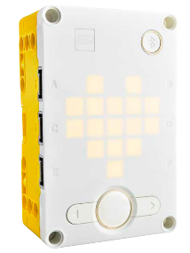
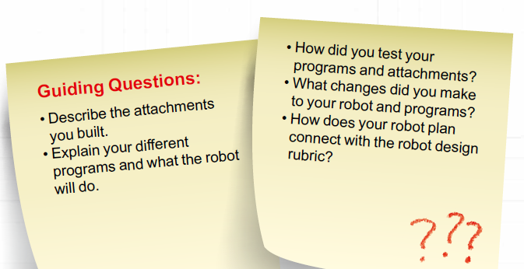
Guiding Questions
Notes:
Team Tasks (100-120 minutes)
Outcomes
Evaluate and improve on their innovation project solution.
Design robot attachments and create programs to solve missions.
Facilitator Tips - Use the Core Values where appropriate to encourage the team. To celebrate the team learning these important values, highlight examples of when the team demonstrates these principles.
Session 8 Tips =
Have the team discuss how the guided mission is an example of Coopertition®.
The team should think about strategy when choosing missions to solve. Multiple missions can be completed on the same run to save time.
Encourage the team to discuss how their program works. Break the program into blocks that control one movement.
Treat the robot game like a sport. The team needs to practice, practice, practice to perform consistently in the robot game.
Where the robot starts in a launch area strongly influences where it ends. Have the team keep good notes about where to place the robot.
The team can create a survey to evaluate their solution or ask for feedback from an expert or user of their chosen problem.
The team should iterate and improve their innovation project solution following feedback from others.
Consider inviting an expert or user to this session to share content about their identified problem.
The team should reference the rubrics so they can be prepared for judging at the event.
The team should think about who their innovative project solution is for.

Slide 7

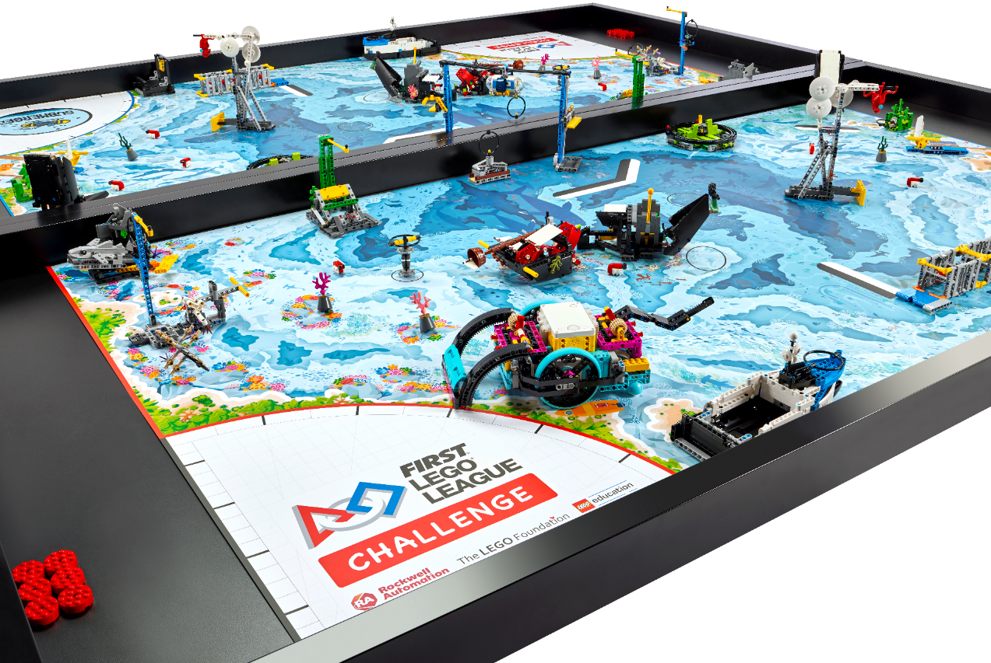
Reflection Questions
How has your team used Core Values to develop your robot solution?
In what order will you run the missions in the Robot Game?
Notes:
Team Tasks (100-120 minutes)
Outcomes
Evaluate and improve on their innovation project solution.
Design robot attachments and create programs to solve missions.
Facilitator Tips - Use the Core Values where appropriate to encourage the team. To celebrate the team learning these important values, highlight examples of when the team demonstrates these principles.
Session 8 Tips =
Have the team discuss how the guided mission is an example of Coopertition®.
The team should think about strategy when choosing missions to solve. Multiple missions can be completed on the same run to save time.
Encourage the team to discuss how their program works. Break the program into blocks that control one movement.
Treat the robot game like a sport. The team needs to practice, practice, practice to perform consistently in the robot game.
Where the robot starts in a launch area strongly influences where it ends. Have the team keep good notes about where to place the robot.
The team can create a survey to evaluate their solution or ask for feedback from an expert or user of their chosen problem.
The team should iterate and improve their innovation project solution following feedback from others.
Consider inviting an expert or user to this session to share content about their identified problem.
The team should reference the rubrics so they can be prepared for judging at the event.
The team should think about who their innovative project solution is for.

Slide 8
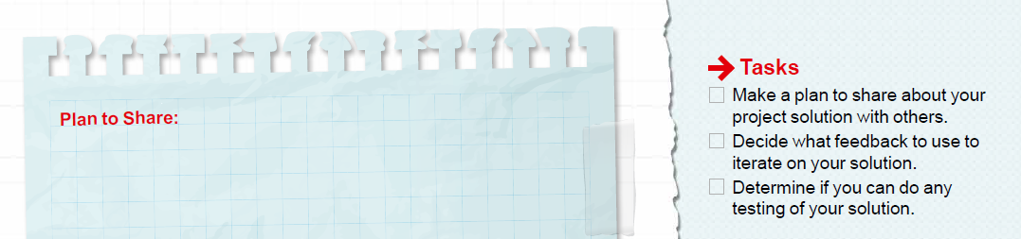
Evaluate & Test Project Solution
Make a plan to share about your solution with others!
Evaluate your present solution.
Notes:
Team Tasks (100-120 minutes)
Outcomes
Evaluate and improve on their innovation project solution.
Design robot attachments and create programs to solve missions.
Facilitator Tips - Use the Core Values where appropriate to encourage the team. To celebrate the team learning these important values, highlight examples of when the team demonstrates these principles.
Session 8 Tips =
Have the team discuss how the guided mission is an example of Coopertition®.
The team should think about strategy when choosing missions to solve. Multiple missions can be completed on the same run to save time.
Encourage the team to discuss how their program works. Break the program into blocks that control one movement.
Treat the robot game like a sport. The team needs to practice, practice, practice to perform consistently in the robot game.
Where the robot starts in a launch area strongly influences where it ends. Have the team keep good notes about where to place the robot.
The team can create a survey to evaluate their solution or ask for feedback from an expert or user of their chosen problem.
The team should iterate and improve their innovation project solution following feedback from others.
Consider inviting an expert or user to this session to share content about their identified problem.
The team should reference the rubrics so they can be prepared for judging at the event.
The team should think about who their innovative project solution is for.

Slide 9
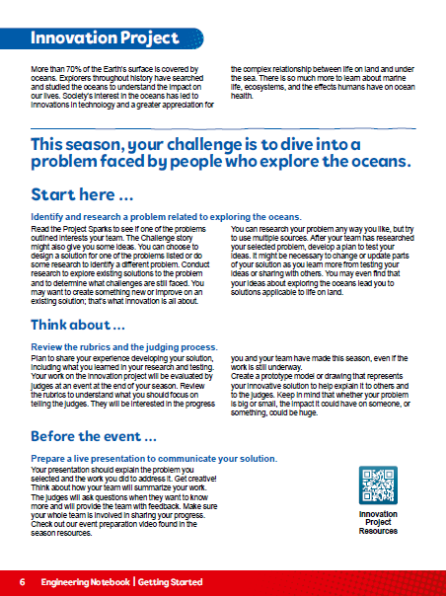

Evaluate & Test Project Solution
Determine if you can do any testing of your solution.
Notes:
Team Tasks (100-120 minutes)
Outcomes
Evaluate and improve on their innovation project solution.
Design robot attachments and create programs to solve missions.
Facilitator Tips - Use the Core Values where appropriate to encourage the team. To celebrate the team learning these important values, highlight examples of when the team demonstrates these principles.
Session 8 Tips =
Have the team discuss how the guided mission is an example of Coopertition®.
The team should think about strategy when choosing missions to solve. Multiple missions can be completed on the same run to save time.
Encourage the team to discuss how their program works. Break the program into blocks that control one movement.
Treat the robot game like a sport. The team needs to practice, practice, practice to perform consistently in the robot game.
Where the robot starts in a launch area strongly influences where it ends. Have the team keep good notes about where to place the robot.
The team can create a survey to evaluate their solution or ask for feedback from an expert or user of their chosen problem.
The team should iterate and improve their innovation project solution following feedback from others.
Consider inviting an expert or user to this session to share content about their identified problem.
The team should reference the rubrics so they can be prepared for judging at the event.
The team should think about who their innovative project solution is for.

Slide 10

Share
Get together at the mat.
Show any missions you are working on or have completed.
Discuss how you will share your solution and project plan with others.
Discuss the reflection questions.
Clean up your space.
Notes:
Share (10-15 minutes)
Outcomes
Evaluate and improve on their innovation project solution.
Design robot attachments and create programs to solve missions.
Facilitator Tips - Use the Core Values where appropriate to encourage the team. To celebrate the team learning these important values, highlight examples of when the team demonstrates these principles.
Session 8 Tips =
Have the team discuss how the guided mission is an example of Coopertition®.
The team should think about strategy when choosing missions to solve. Multiple missions can be completed on the same run to save time.
Encourage the team to discuss how their program works. Break the program into blocks that control one movement.
Treat the robot game like a sport. The team needs to practice, practice, practice to perform consistently in the robot game.
Where the robot starts in a launch area strongly influences where it ends. Have the team keep good notes about where to place the robot.
The team can create a survey to evaluate their solution or ask for feedback from an expert or user of their chosen problem.
The team should iterate and improve their innovation project solution following feedback from others.
Consider inviting an expert or user to this session to share content about their identified problem.
The team should reference the rubrics so they can be prepared for judging at the event.
The team should think about who their innovative project solution is for.

Slide 11
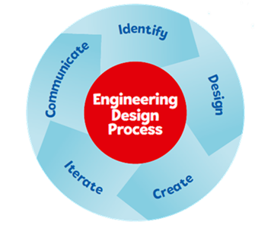

Reflection Questions
How can you test your innovation project solution?
How will you know if your solution is going to make a positive impact on others?
Notes:
Outcomes
Evaluate and improve on their innovation project solution.
Design robot attachments and create programs to solve missions.
Facilitator Tips - Use the Core Values where appropriate to encourage the team. To celebrate the team learning these important values, highlight examples of when the team demonstrates these principles.
Session 8 Tips =
Have the team discuss how the guided mission is an example of Coopertition®.
The team should think about strategy when choosing missions to solve. Multiple missions can be completed on the same run to save time.
Encourage the team to discuss how their program works. Break the program into blocks that control one movement.
Treat the robot game like a sport. The team needs to practice, practice, practice to perform consistently in the robot game.
Where the robot starts in a launch area strongly influences where it ends. Have the team keep good notes about where to place the robot.
The team can create a survey to evaluate their solution or ask for feedback from an expert or user of their chosen problem.
The team should iterate and improve their innovation project solution following feedback from others.
Consider inviting an expert or user to this session to share content about their identified problem.
The team should reference the rubrics so they can be prepared for judging at the event.
The team should think about who their innovative project solution is for.

Slide 12

Multimedia Resources
You may wish to embed a relevant, age-appropriate video for your students here.
Notes:
Choose a relevant, age-appropriate video for your students.

Slide 13

Clean Up
Notes:
Allow time for cleanup and place any unfinished models and their pieces in a sealed plastic bag.
Clean Up Pointers
You may wish to play a video or song during clean up time Link on
GoNoodle: https://family.gonoodle.com/activities/clean-up
Link on YouTube Kids: https://www.youtubekids.com/watch?v=ZJFk87ZsHn0
Link on Youtube: https://youtu.be/ZJFk87ZsHn0

Slide 14


LEGO, the LEGO logo, the SPIKE logo, MINDSTORMS and the MINDSTORMS logo are trademarks of the/sont des marques de commerce du/son marcas registradas de LEGO Group. ©2024 The LEGO Group. All rights reserved/Tous droits réservés/Todos los derechos reservados. FIRST ®, the FIRST ® logo, Coopertition ®, Gracious Professionalism®, and FIRST® DIVESM are trademarks of For Inspiration and Recognition of Science and Technology (FIRST). LEGO® is a registered trademark of the LEGO Group. FIRST® LEGO® League and SUBMERGEDSM are jointly held trademarks of FIRST and the LEGO Group. All other trademarks are the property of their respective owners. ©2024 FIRST and the LEGO Group. All rights reserved.

